Slide 1
CSE 445 Lecture 11
Model evaluation & selection

Slide 2
Cross validation
The training set error is not indicative of the model error when applied to new data
To get a good estimate of what error rate will be for new data, we must use a more sophisticated methodology called cross-validation (often abbreviated CV) that rigorously uses the training set to evaluate what the accuracy will be on new data
There are two kinds of cross validation methods
Hold out method
K-fold method

Slide 3
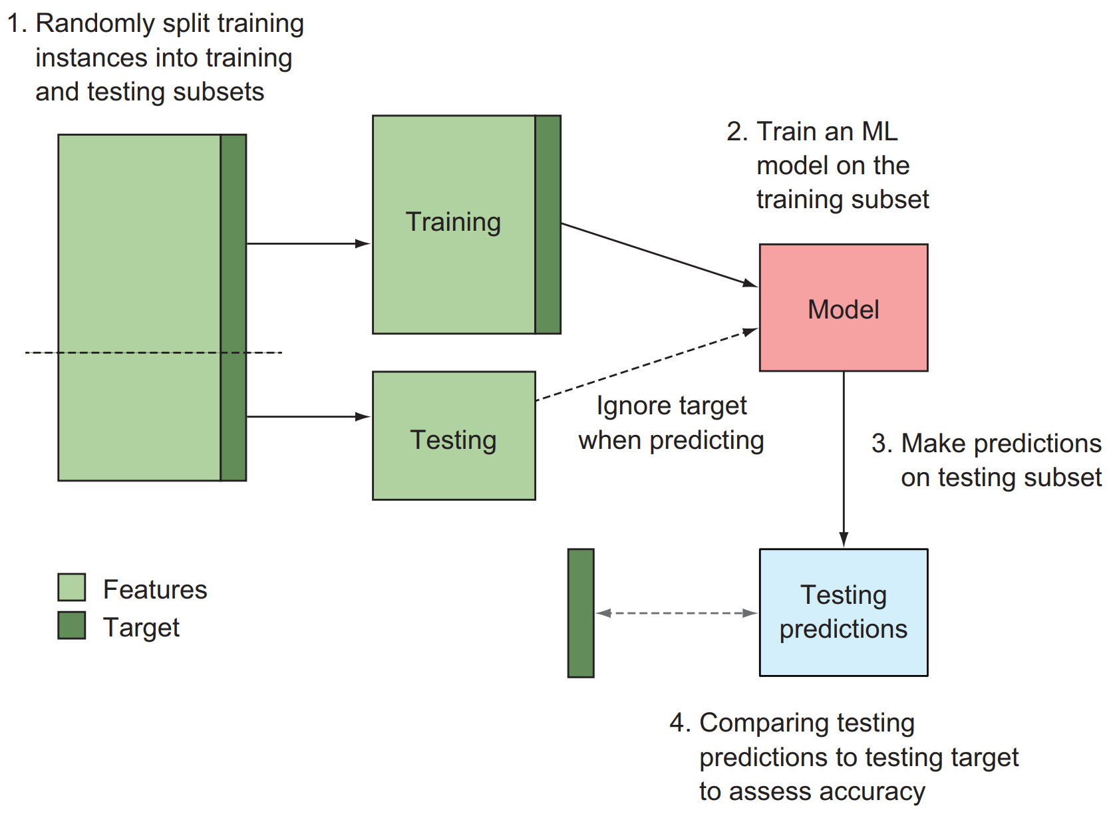
Hold out cross validation

Slide 4
Hold out cross validation
Hold out cross validation suffers from bad split
The main things stand out
The holdout error estimates are noisy
However, the error estimates computed by the holdout method follows the error to the new-data

Slide 5
K-fold cross validation
A better but more computationally intensive approach to cross-validation is k-fold cross validation
Like the holdout method, k-fold cross-validation relies on quarantining subsets of the training data during the learning process
The primary difference is that k-fold CV begins by randomly splitting the data into k disjoint subsets, called folds (typical choices for k are 1, 5, 10, or 20)
When k is 1, it is called leave one out cross validation
For each fold, a model is trained on all the data except the data from that fold and is subsequently used to generate predictions for the data from that fold
After all k-folds are cycled through, the predictions for each fold are aggregated and compared to the true target variable to assess accuracy

Slide 6
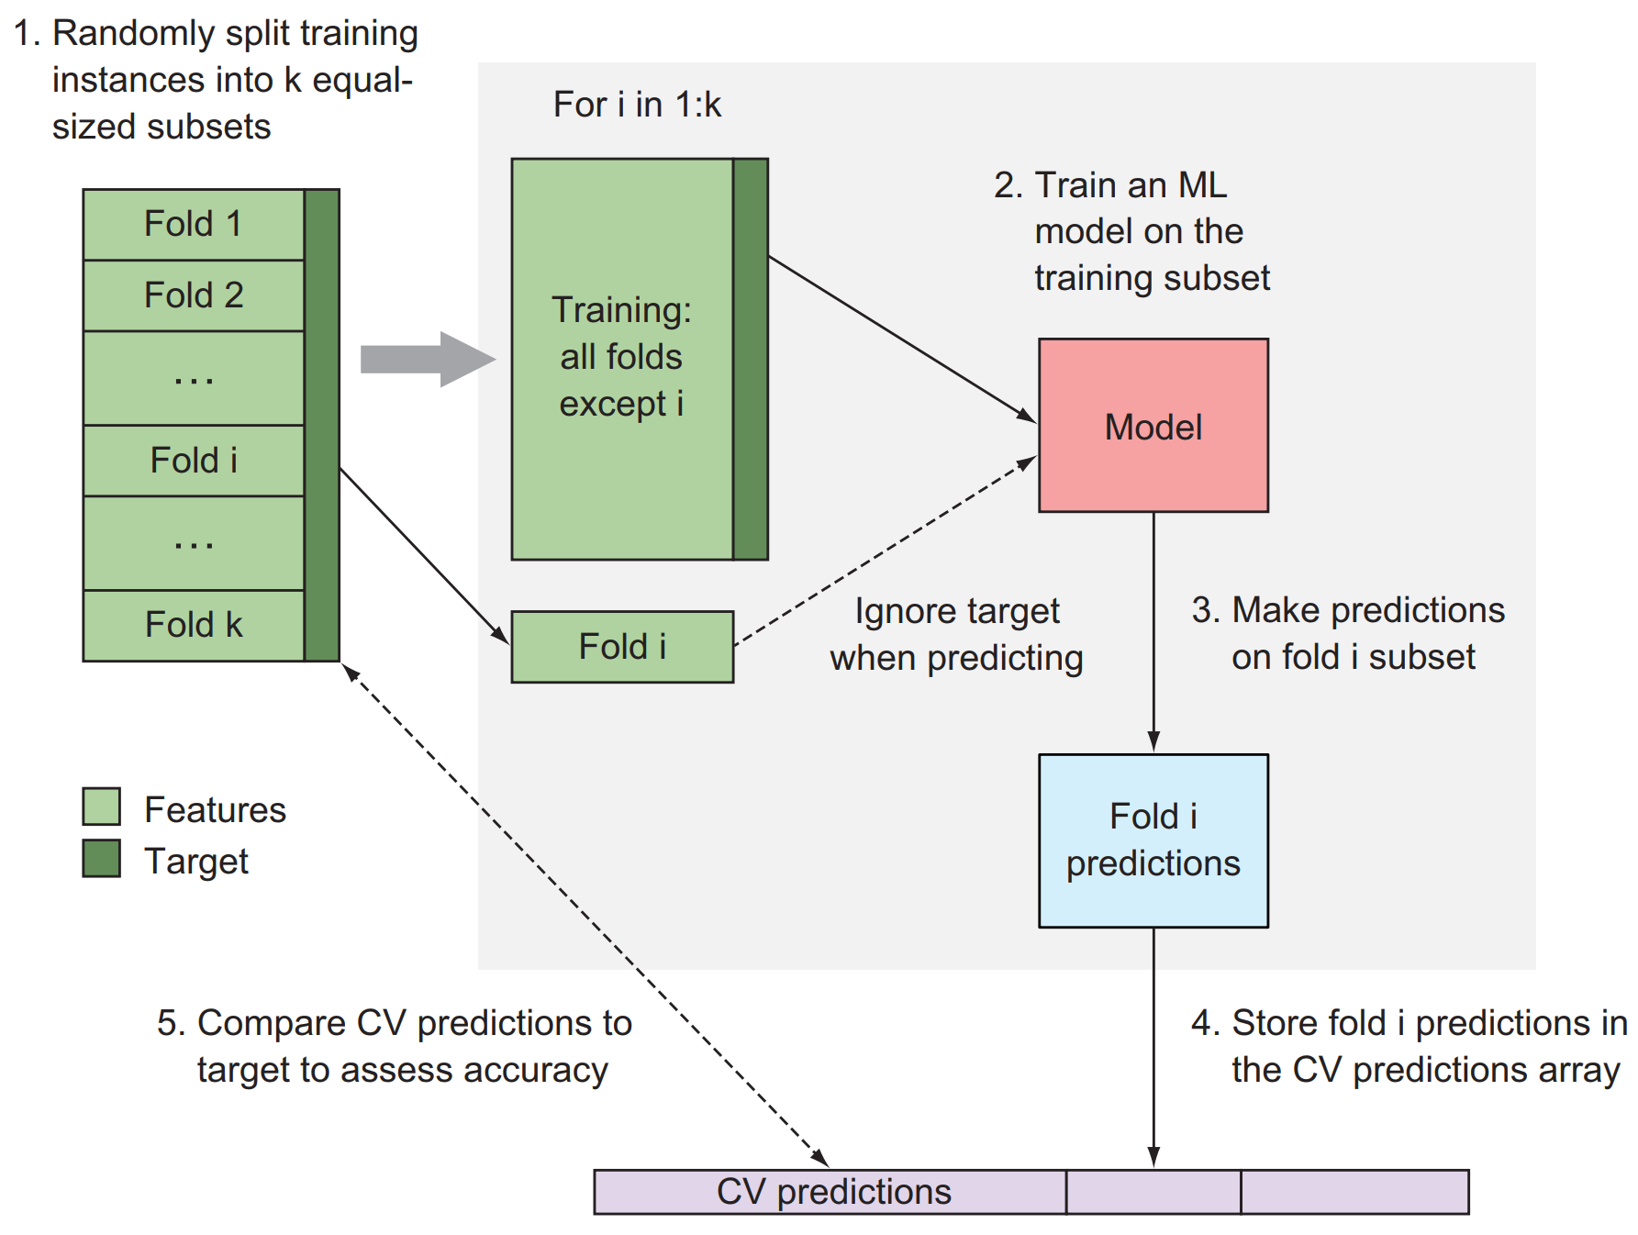
K-fold cross validation

Slide 7
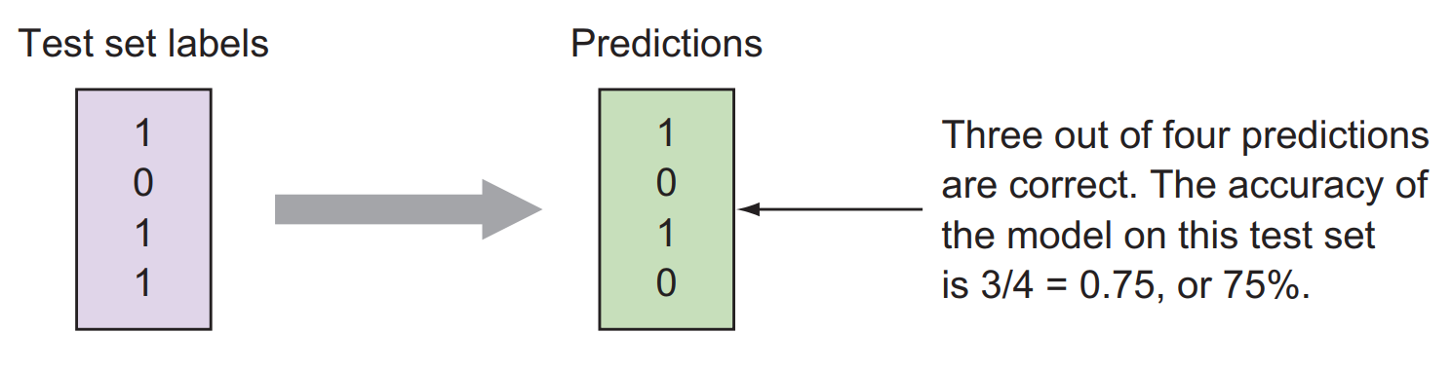
Accuracy metric – MSE for classification?
The simplest performance measure of a classification model is to calculate the fraction of correct answers
If three out of four rows were correctly predicted, we can say that the accuracy of the model on this particular validation set is 3/4 = 0.75, or 75%

Slide 8
Class accuracy
The predictions should provide more information than simply being correct or not
We should be able to analyze the accuracy per class (how many were predicted to survive but actually died or survived)
For binary classification, you can be wrong in two ways – predicting 0 when the correct value is 1, or predicting 1 when the correct value is 0
In many classification problems, it’s useful to go beyond the simple counting accuracy and look at this class-wise accuracy, or class confusion

Slide 9
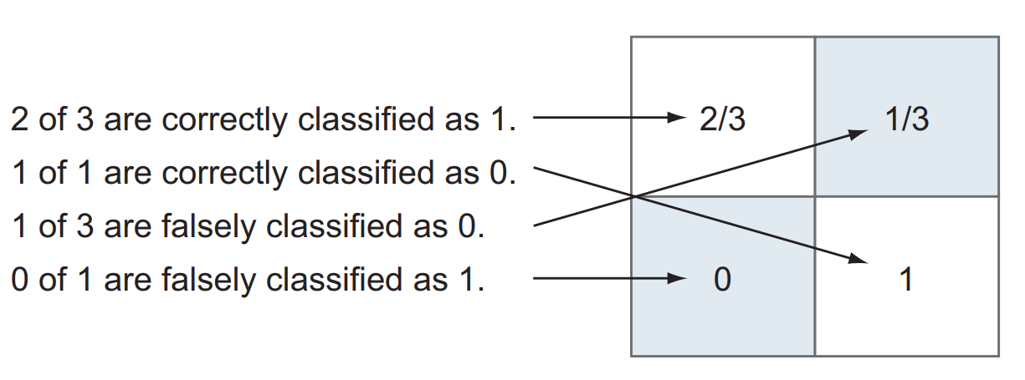
Accuracy – confusion matrix
It turns out to be useful to display these four numbers in a two-by-two diagram called a confusion matrix

Slide 10
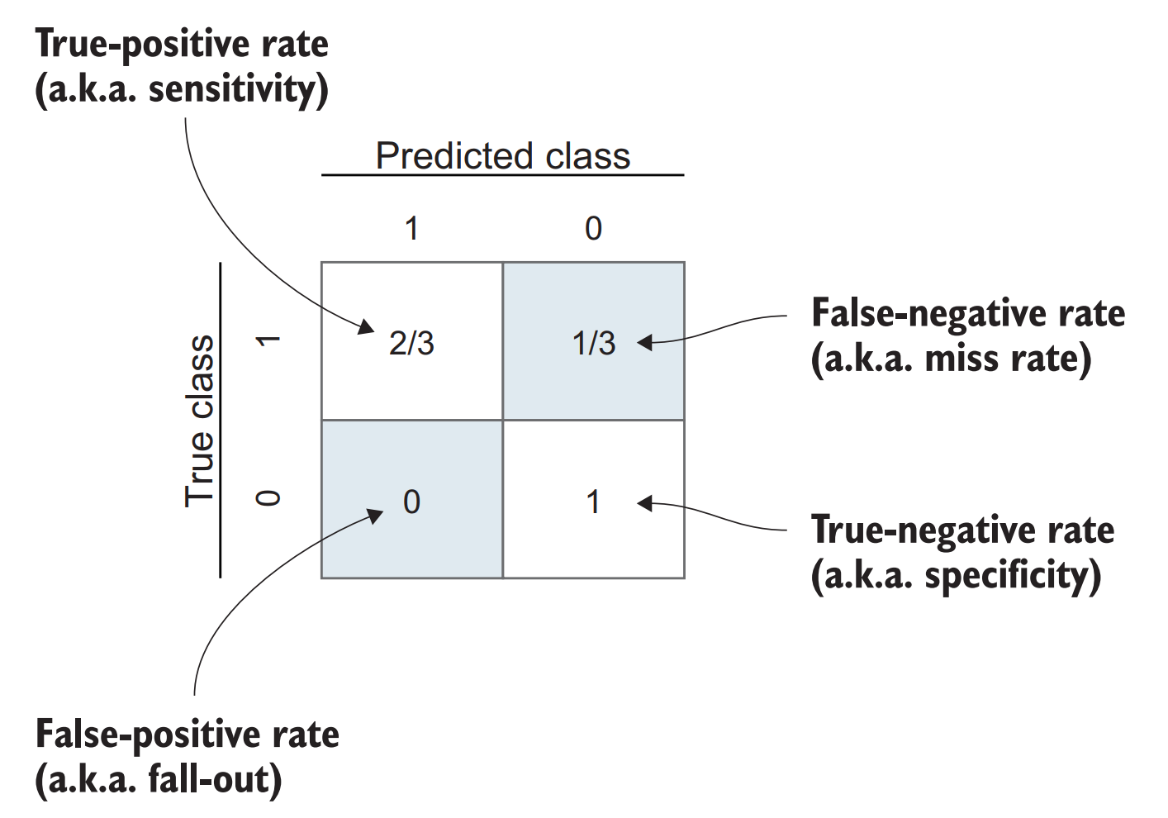
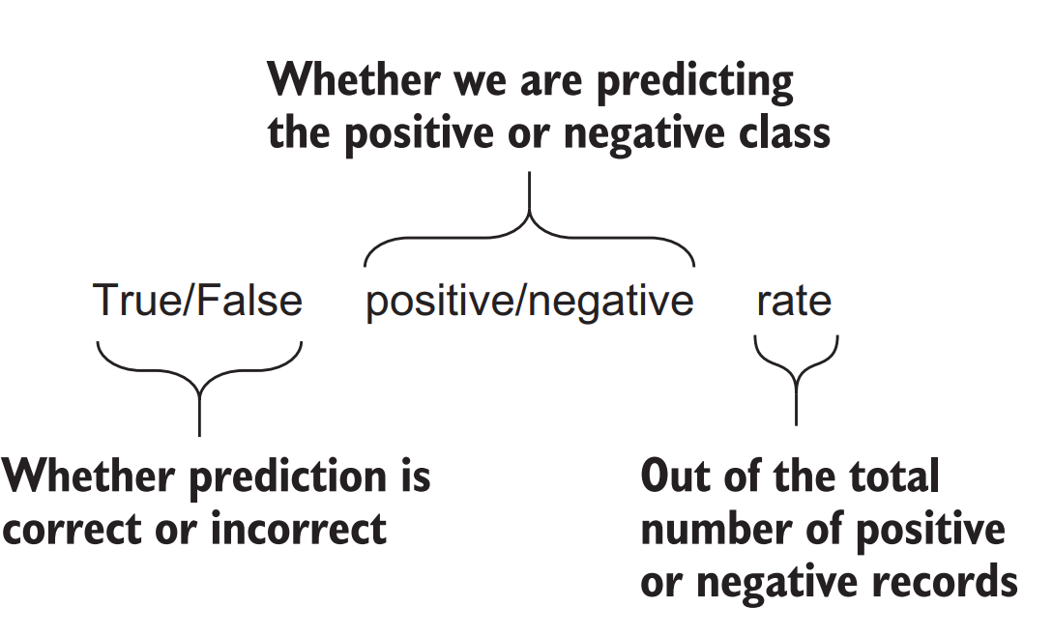
Confusion matrix
Each element in the matrix shows the class-wise accuracy or confusion between the positive and the negative class
They are related to the general concept of receiver operating characteristics (ROCs)

Slide 11
ROC Curve
The output of a probabilistic classifier is the probability vectors or class probabilities
For every row in the test set, we get a real-valued number from 0 to 1 for every class in the classifier (summing to 1)
We can make predictions by considering probabilities above 0.5 to determine the class predictions, from which we can calculate all the performance metrics (for logistic regression)
We say that the threshold that determines the class is 0.5 (for logistic regression)
It’s clear that we can choose any other threshold and would get different values for all of our metrics

Slide 12
ROC Curve
Figure in next slide shows the process of sorting the probability vectors and setting a threshold of 0.7.
If we follow this process for all thresholds from 0 to 1, we get the ROC curve, shown in next slide
Here we can read out the confusion matrix at all thresholds, making the ROC curve a powerful visualization tool when we’re evaluating classifier performance

Slide 13
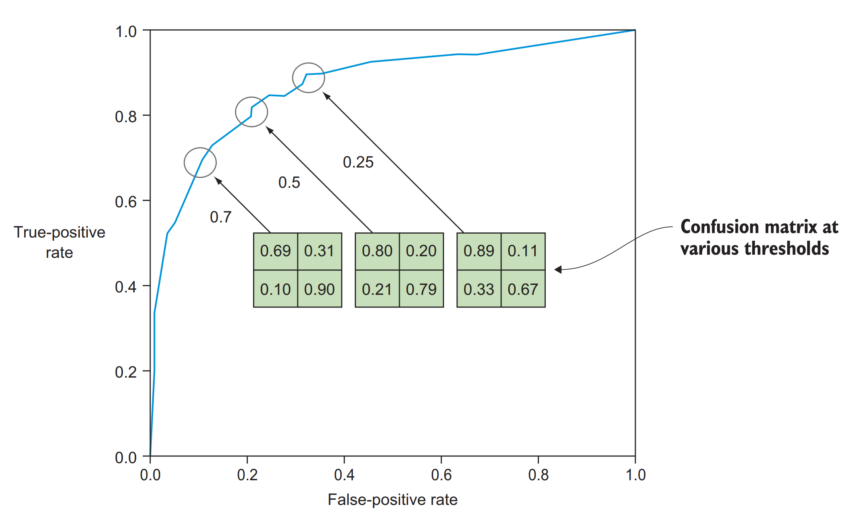
ROC Curve

Slide 14
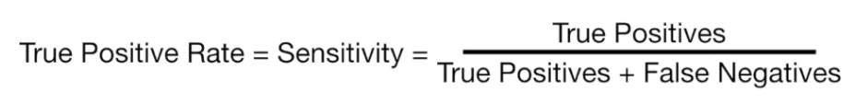
Definitions

Slide 15
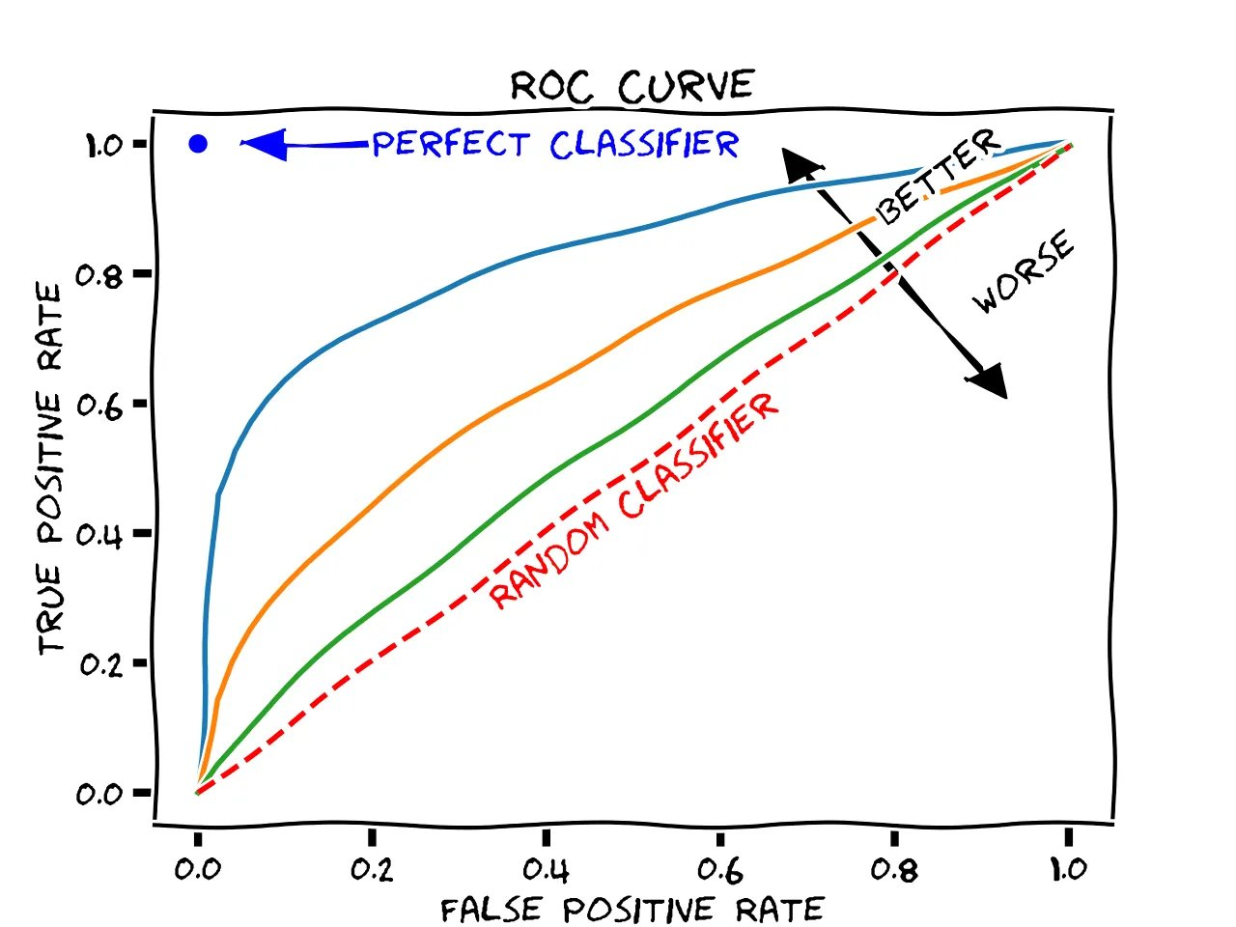

Slide 16
AUC Curve
The ROC curve itself also provides a view of the overall performance of the classifier
A perfect classifier would have no false positives and no missed detections, so the curve would be pushed to the top-left corner, as illustrated in the next (slide’s) figure
This leads us naturally to another evaluation metric: the area under the ROC curve (AUC)
The larger this area, the better the classification performance
The AUC is a widely used choice for evaluating and comparing models, although in most cases it’s important to inspect the full ROC curve

Slide 17
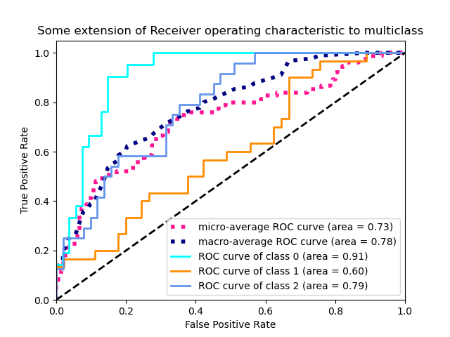
AUC

Slide 18
Metrics

Slide 19
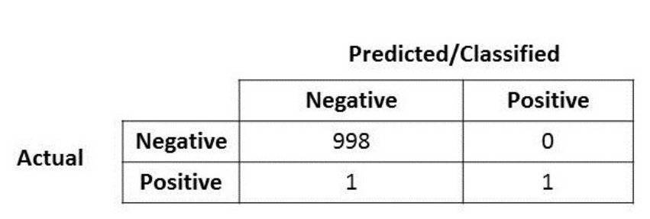
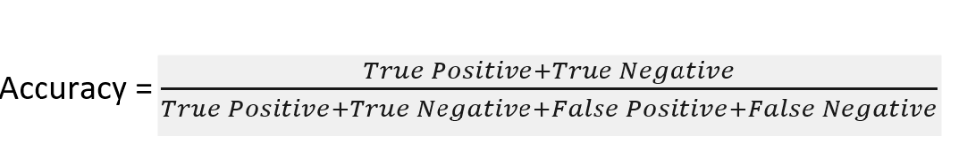
Accuracy
What is the accuracy of the model which have the following confusion matrix?

Slide 20
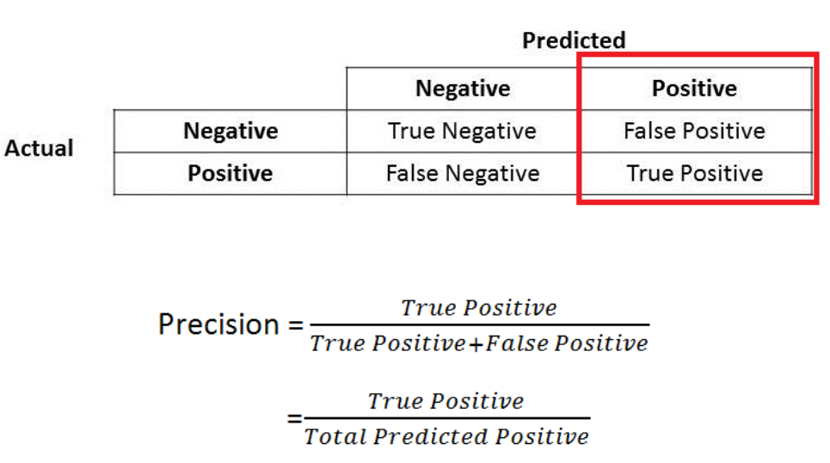
Precision and Recall

Slide 21
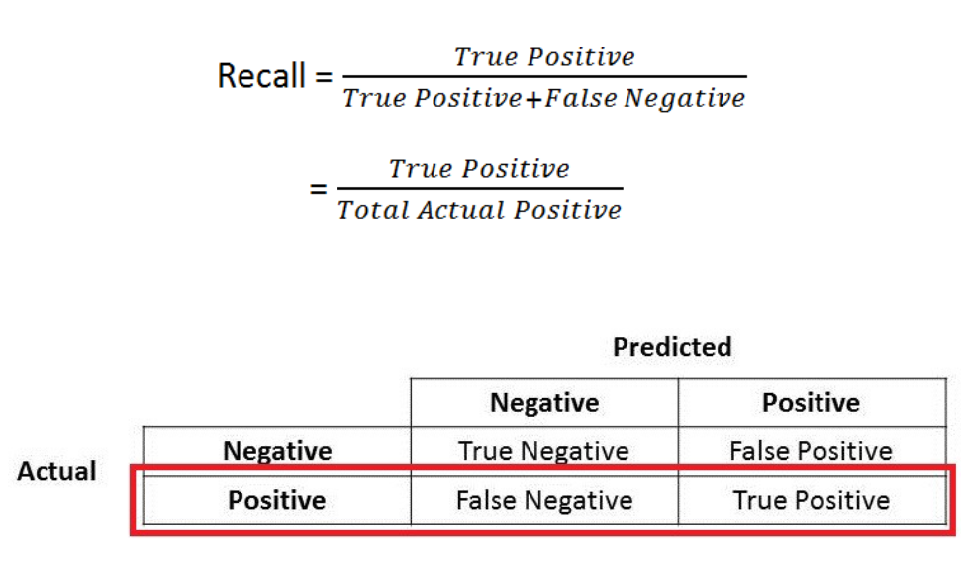
Precision and Recall

Slide 22
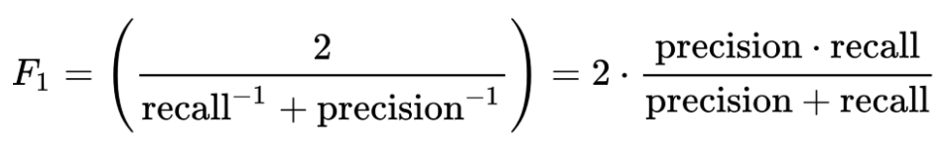
F₁ Score: combining two into one
F1 Score is the weighted average of Precision and Recall
It takes both false positives and false negatives into account
Intuitively it is not as easy to understand as accuracy, but F1 is usually more useful than accuracy, especially if we have an uneven class distribution
Accuracy works best if false positives and false negatives have similar cost
If the cost of false positives and false negatives are very different, it’s better to look at both Precision and Recall

